Slide 1
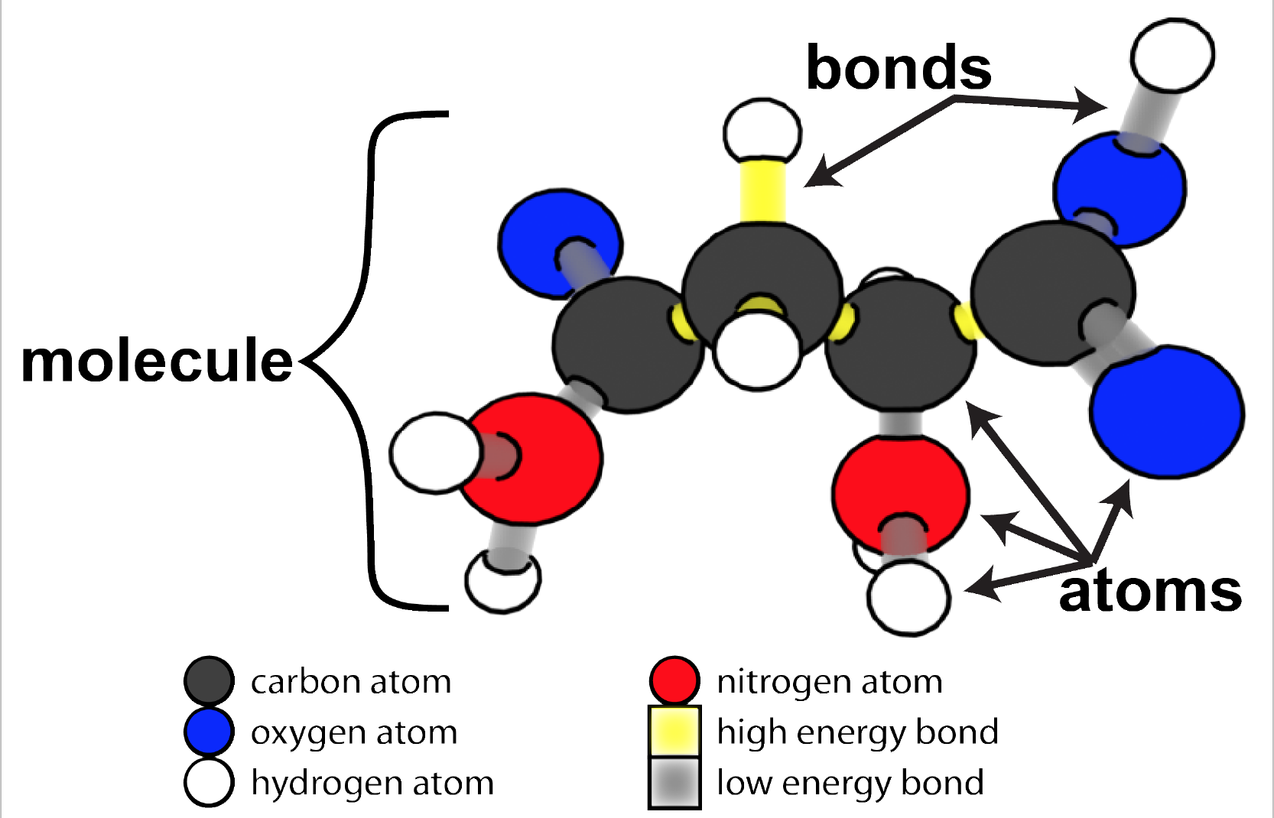
Notes:
Review how atoms bond together to make molecules/
Credit: Craig Douglas, Michigan State University

Slide 2
Facts and questions about organisms
Some things we know:
Some unanswered questions
All organisms are made of cells
All the functions of organisms are done by cells working together
All cells are made of molecules
All molecules are made of atoms
What kinds of molecules are cells made of?
How do those molecules move and change when cells do their functions, such as:
Growing
Moving
Changing matter and energy?
Notes:
Review some things we know in the left column
Review unanswered questions in the right column

Slide 3
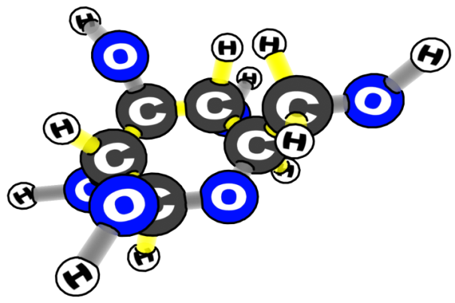
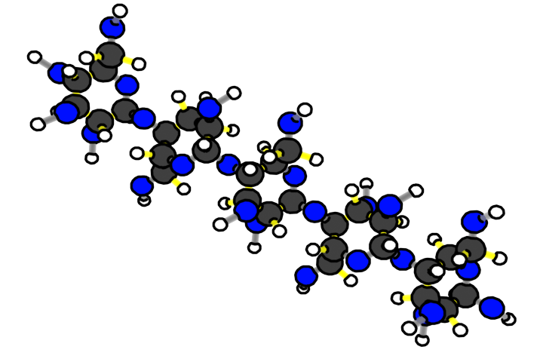
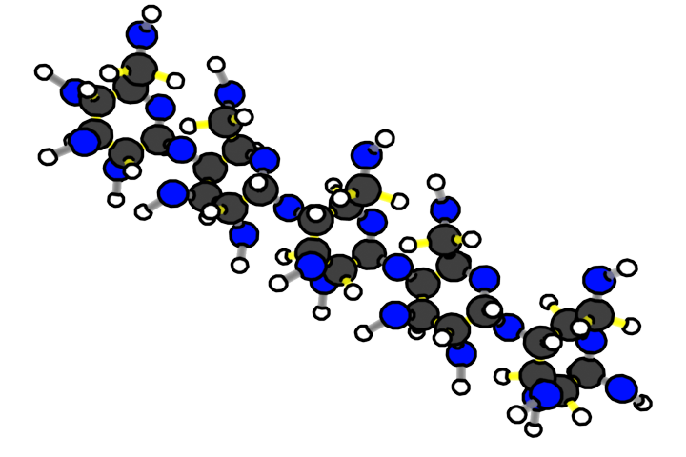
What are cells made of? CARBOHYDRATES
fiber
glucose
What atoms are carbohydrates made of?
starch
Notes:
focus on carbohydrates,

Slide 4
Carbohydrates
Atoms Present | Types of Bonds Present | Examples
Carbon Hydrogen Oxygen | C-H C-C C-O O-H | Starch Fiber Glucose

Slide 5
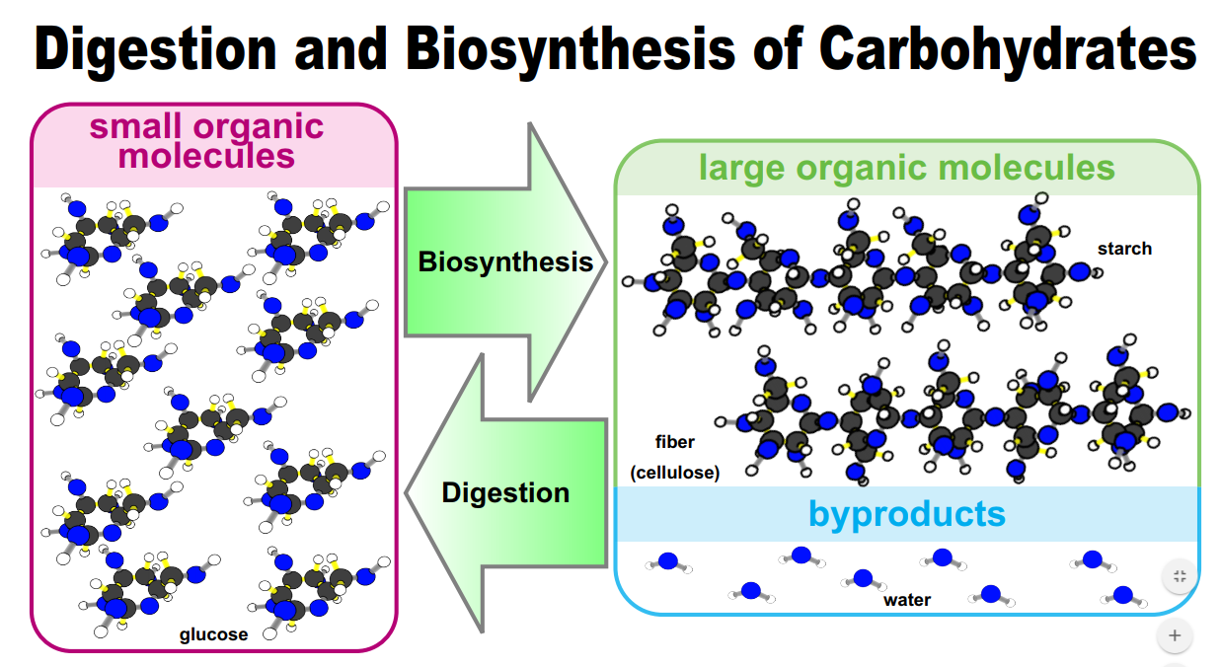
Large Organic Molecules taken apart during digestion
Byproduct of Biosynthesis AND Inorganic molecules used during digestion
Monomer put together during Biosynthesis

Slide 6
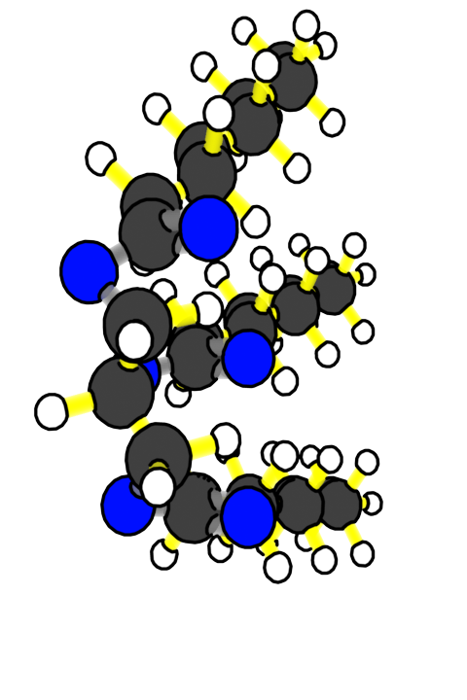
What are cells made of? FATS
What atoms are fats made of?
1 glycerol
3 fatty acids
Fat molecule
Notes:
focus on fats, including the atoms in fat molecules (CHO)

Slide 7
Lipids
Atoms Present | Types of Bonds Present | Examples
Carbon Hydrogen Oxygen | C-H C-C C-O O-H | Oil Wax Cholesterol

Slide 8
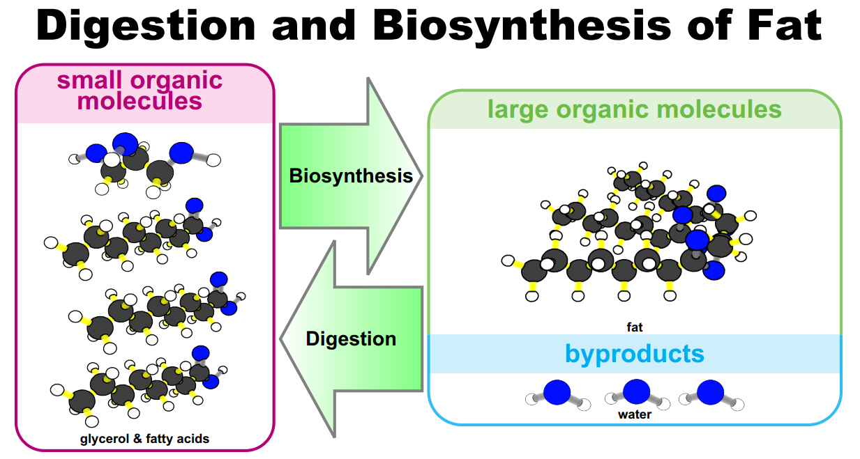
Large Organic Molecules taken apart during digestion
Byproduct of Biosynthesis AND Inorganic molecules used during digestion
Monomer put together during Biosynthesis

Slide 9
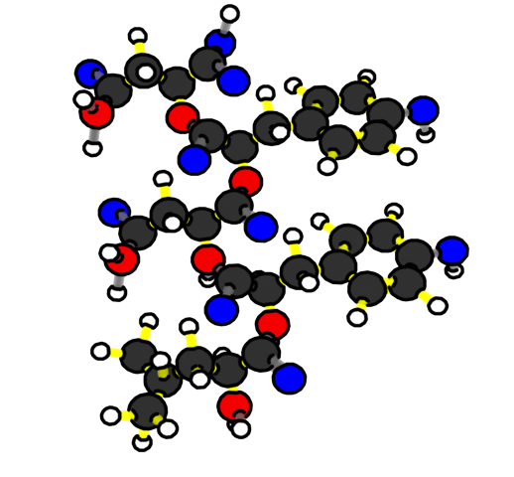
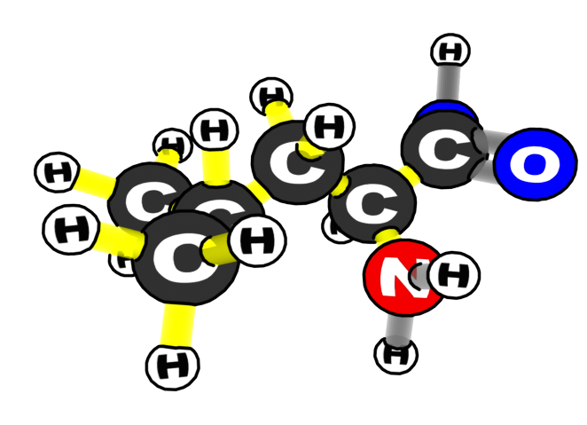
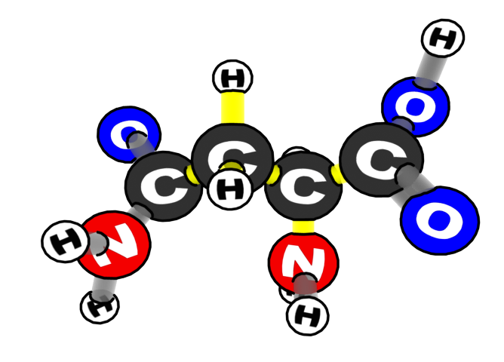
What are cells made of? PROTEIN
Two of the Amino Acids
What atoms are proteins made of?
Notes:
Slides 10 and 11 focus on proteins, including the atoms in protein molecules (CHON)

Slide 10
Proteins
Atoms Present | Types of Bonds Present | Examples
Carbon Hydrogen Oxygen Nitrogen | C-H C-C C-O C-N N-H O-H | Hemoglobin Insulin

Slide 11
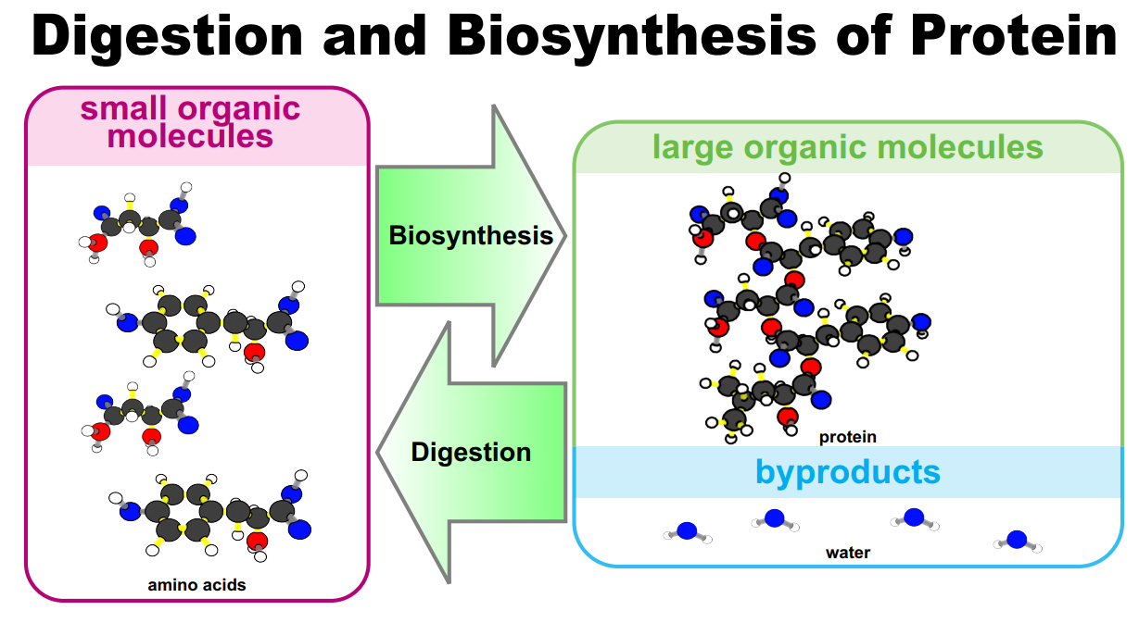
Large Organic Molecules taken apart during digestion
Byproduct of Biosynthesis AND Inorganic molecules used during digestion
Monomer put together during Biosynthesis

Slide 12
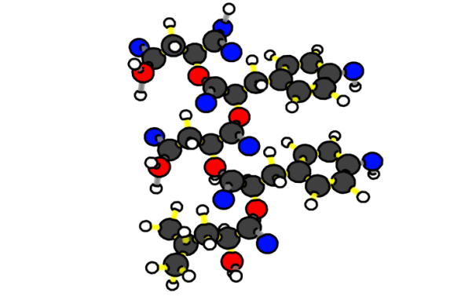
Organic Molecules in All Cells
CARBOHYDRATES:
GLUCOSE
FATS
STARCH
What atoms are organic molecules in cells made of?
PROTEINS
Notes:
Slide 8 points out that all the organic molecules in cells are made primarily of 4 kinds of atoms: CHON. (If you wish to discuss other atoms in organic molecules such as P and S, you could do so later with Slides 21 and 22.)

Slide 13
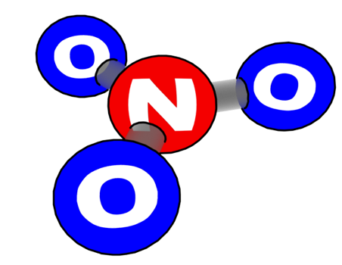
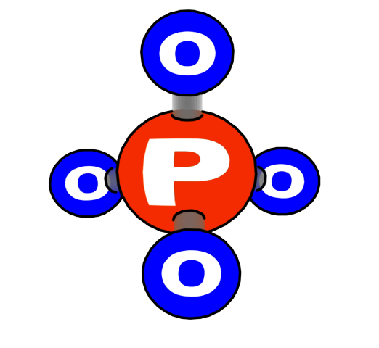
Minerals in Cells
Cells also contain minerals that are used for cell functions. These minerals have different kinds of atoms, including:
Nitrogen
Phosphorous
Calcium
Sodium
Notes:
Slides 9 point to cholesterol, vitamins, and minerals: molecules found in cells but always less than 1% of cell mass.

Slide 14
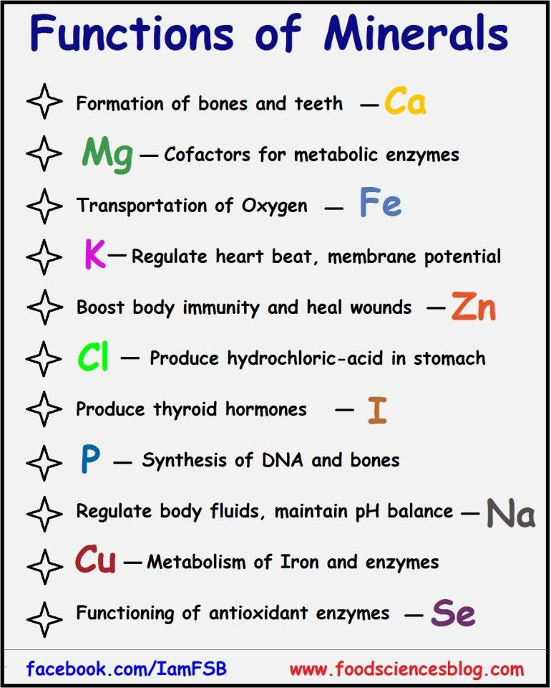
Functions of Minerals in the Body

Slide 15
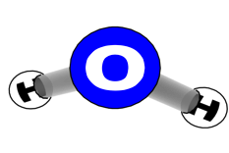
Which molecules have chemical energy?
CARBOHYDRATES:
GLUCOSE
STARCH
FATS
Remember: Yellow bonds are high energy and gray bonds are low energy
MINERALS
WATER
PROTEINS

Slide 16
Connecting back to the Food Label analysis Review the data you collected about the six different food types in the Food Label analysis activity. Based on what you have learned, use the CER organizer to construct an explanation for why the beef and peanuts had significantly higher amounts of chemical energy (Calories) than the foods based on plant parts even though they all had the same mass?
Claim: Peanuts and beef had much higher calories because they have more…. Compared to …..
Evidence: Give numbers of how many grams of these molecules they had
Reasoning Explain which molecules have the highest calorie content and why

Slide 17
Source:

